Slide 1



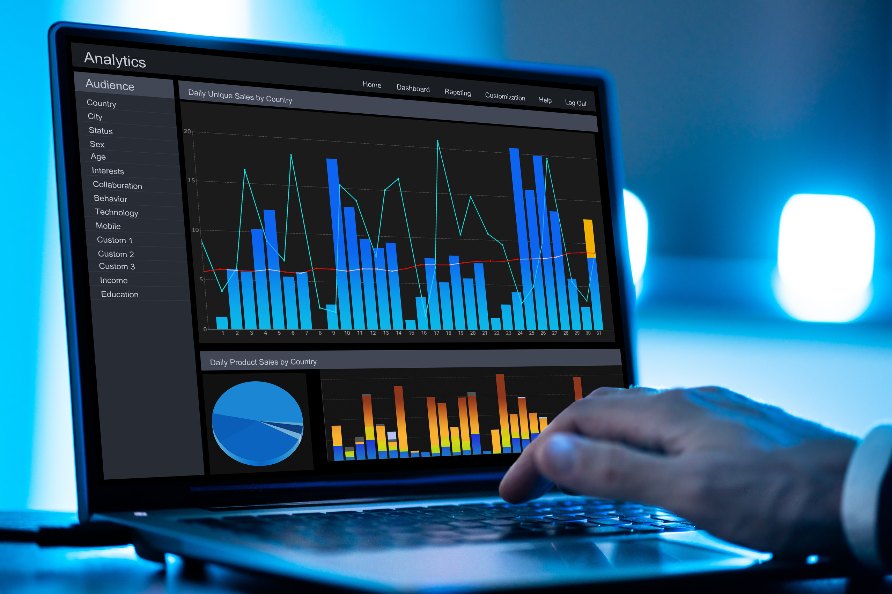
University of Bradford
Breast Cancer Diagnosis Using Machine Learning
Presented by
Omidu Jayasinghe
Ub 24027835

Slide 2



Introduction
Breast cancer is one of the most common cancers in women worldwide.
Finding it early helps treatment and can reduce unnecessary procedures.
Biomedical data can be complex and hard toanalyse by humans.
Data science can help by finding patterns in measurements using machine learning

Slide 3


Dataset Overview: Breast Cancer Wisconsin (Diagnostic)
  Source: UCI / Kaggle Breast Cancer Wisconsin (Diagnostic)
  Goal: predict Benign (B) vs Malignant (M)
  Data size: 569 samples
  Features: 30 numeric features from FNA image measurements
  Class counts
    357 benign
    212 malignant

Slide 4
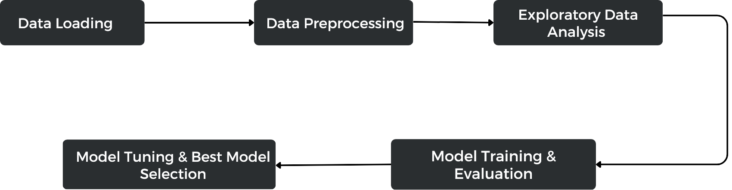
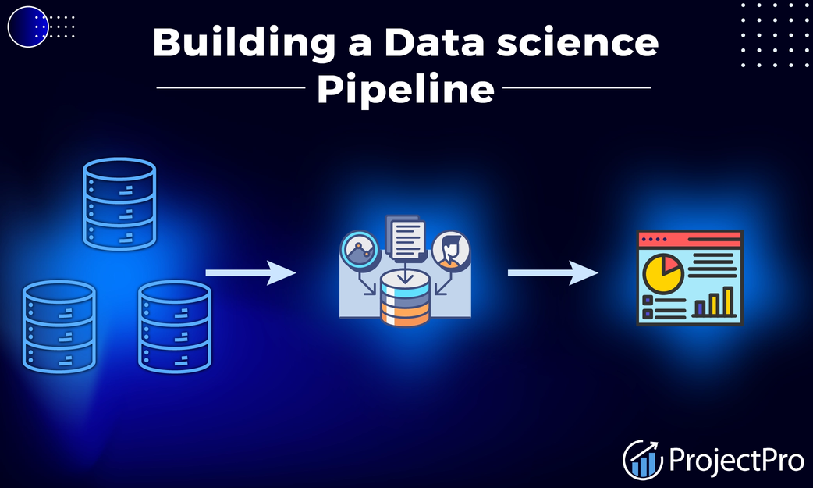

Data Science Pipeline

Slide 5

Data Cleaning & Preprocessing
  Removed non-informative column (Unnamed: 32)
  Drop columns that does not help prediction.g
  Remove Highly Corelated Feature
    radius_mean, radius_worst, area_mean
  Feature Scalling
    StandardScaler (z-score)
    MinMaxScaler (0–1)

Slide 6
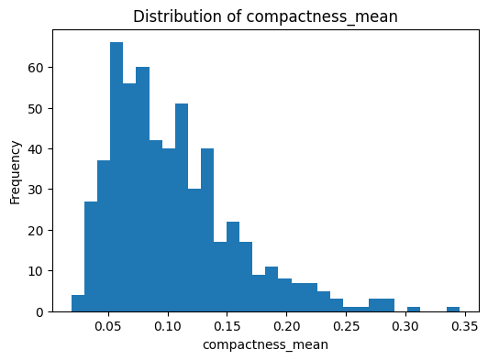
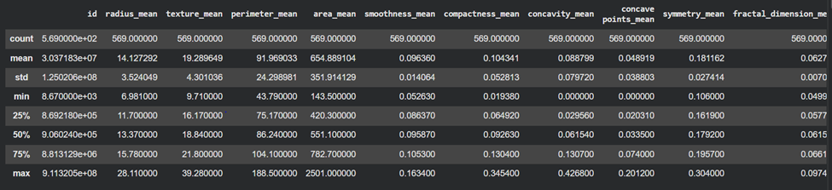
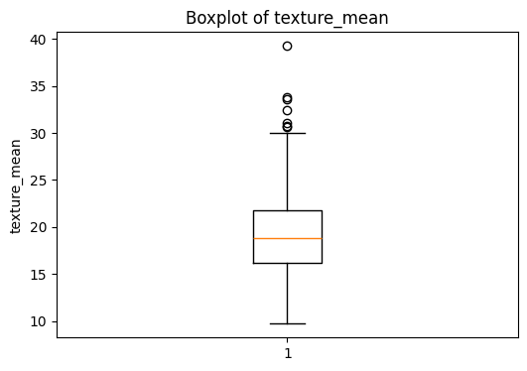
Descriptive Analytics Insights
Data Distribution Visualization
  Most features are skewed, not normal andoutliers exist

Slide 7
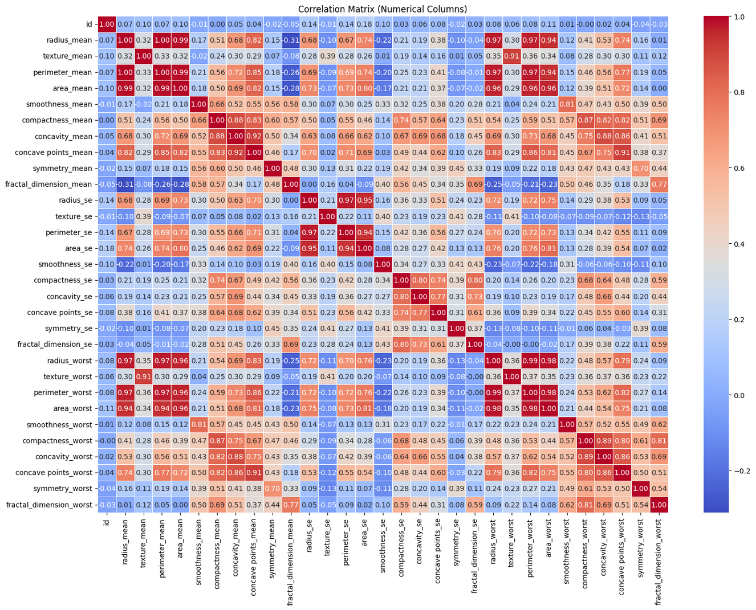

Correlation Analysis
  Strong correlation between size-related features

Slide 8



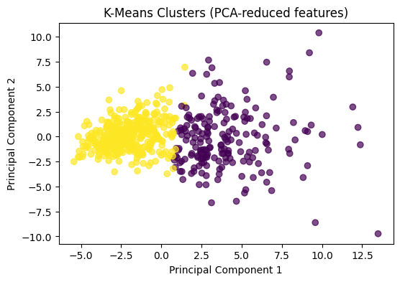
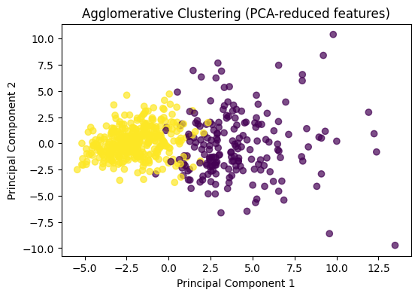
Principal Component Analysis (PCA)
K- Means Clustering
Agglomerative Clustering

Slide 9

Machine Learning Model Development
  Split data into 80% training and 20% testing (stratified to keep class balance)
  Train each model on two scaled datasets:
    StandardScaler Dataset
    MinMaxScaler Dataset
  Model trained algorithms
    Logistic Regression, SVM (RBF), KNN
    Decision Tree, Random Forest
    Gradient Boosting, AdaBoost, Extra Trees, XGBoost
  Hyperparameter tuning: tuned the best models (Random Forest and XGBoost) using RandomizedSearchCV

Slide 10


Validation Metrics & Best Results
Validation Metrics
  Evaluation used
    Confusion Matrix
    Classification Report
    Accuracy
    ROC curve / AUC
Result
  Best performens get by Random Forest and XGBoost
  Random Forest and XGBoost used to Hyperparameter tuning.

Slide 11
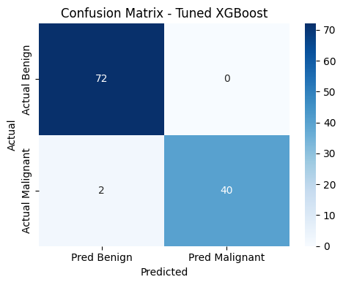
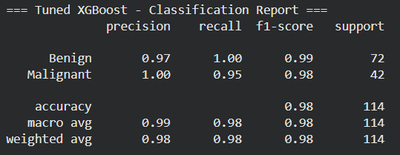
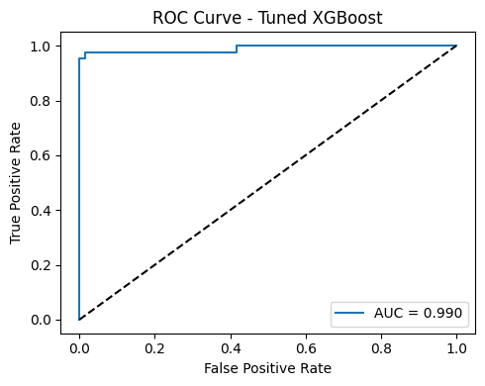
Validation Metrics & Best Results
Best Model Results
  Best results given by the Hyperparameter tuned XGBoost Model with 98% Accuracy

Slide 12


Thank You

